Slide 1
RANDOM FORESTS

Slide 2
Ensemble methods
A single decision tree does not perform well
But, it is super fast
What if we learn multiple trees?
We need to make sure they do not all just learn the same
Voting
Bagging
Boosting
Stacking

Slide 3
Voting
Base models are different
{data point}
Dataset
SVM
DT
LR

Slide 4
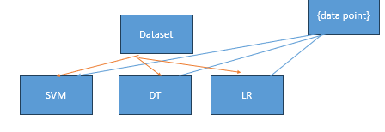
Stacking
KNN

Slide 5
Bagging
If we split the data in random different ways, decision trees give different results, high variance.
Bagging: Bootstrap aggregating is a method that result in low variance.
If we had multiple realizations of the data (or multiple samples), we could calculate the predictions multiple times and take the average of the fact that averaging multiple onerous estimations produce less uncertain results

Slide 6
Bagging
Reduces overfitting (variance)
Normally uses one type of classifier
Decision trees are popular
Easy to parallelize

Slide 7
Boosting
LR1
NB
SVM
D

Slide 8
Trees and Forests
The random forest starts with a standard machine learning technique called a “decision tree” which, in ensemble terms, corresponds to our weak learner. In a decision tree, an input is entered at the top and as it traverses down the tree the data gets bucketed into smaller and smaller sets.

Slide 9
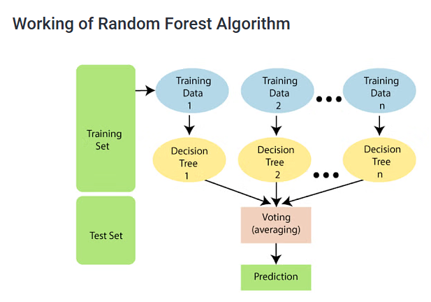

Slide 10
The following steps explain the working Random Forest Algorithm:
Step 1: Select random samples from a given data or training set.
Step 2: This algorithm will construct a decision tree for every training data.
Step 3: Voting will take place by averaging the decision tree.
Step 4: Finally, select the most voted prediction result as the final prediction result.

Slide 11
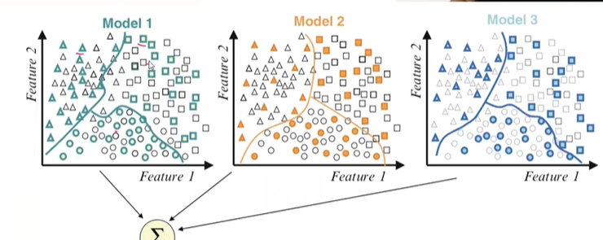
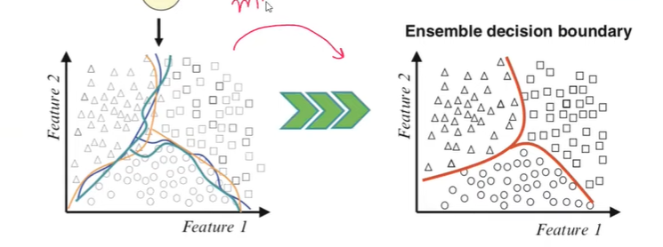
Ensemble Method

Slide 12
Evaluate Performance Over Time:
Increasing the number of trees typically decreases the error rate, but this effect tends to taper off at some point.
To find the optimal number:
  Train the Random Forest model with increasing values of ntree (e.g., 100, 200, 500, 1000).
  Plot the OOB (Out-of-Bag) error rate or cross-validated accuracy as ntree increases to see
  when performance stabilizes.
Consider Dataset Size:
Small datasets (e.g., less than 10,000 rows): 100–500 trees are generally sufficient.
Medium datasets (e.g., tens of thousands of rows): 500–1000 trees may be required.
Large datasets (e.g., hundreds of thousands or millions of rows): 1000 or more trees may be ideal but may require significant computation time.

